Slide 1
Data Structure Analysis and Design

Slide 2
Divide & Conquer

Slide 3
Plan of Lecture
Topics to be covered in Contact Session:
Introduction to the Divide and conquer Strategy
Algorithm and analysis
Merge Sort
Binary Search
Quick Sort
Integer Multiplication

Slide 4
Introduction to Divide and Conquer
What is Divide and Conquer Strategy
Factors affecting:
Design Choice
Number of Sub Problems.
Choice of granularity of Atomic Problems.
Examples:
Merge Sort
Binary Search
Quick Sort
……..

Slide 5
Merge Sort
The merge sort algorithm is defined recursively:
If the list is of size 1:
it is sorted—we are done;
Otherwise:
Divide an unsorted list into two sub-lists,
Sort each sub-list recursively using merge sort,
Merge the two sorted sub-lists into a single sorted list
Question: How quickly can we recombine the two sub-lists into a single sorted list?

Slide 6
Merge Sort
Non In-Place sort (Uses extra space)
2T(n/2) | + | N
Break |  | Merge
15 | 13 | 16 | 3 | 7 | 82 | 8 | 10 | 25

Slide 8
The Algorithm
The algorithm:
Split the list into two approximately equal sub-lists
Recursively call merge sort on both sub lists
Merge the resulting sorted lists
void merge_sort( Type *array, int first, int last )
{
int midpoint = (first + last)/2;
merge_sort( array, first, midpoint );
merge_sort( array, midpoint, last );
merge( array, first, midpoint, last );
}

Slide 9
Run-time Analysis of Merge Sort
Thus, the time required to sort an array of size n > 1 is:
Time required to Sort the first half,
Time required to Sort the second half
Time required to Merge the two lists
That is:
Simplifying this, we have n + n lg(n)
The run time is Θ(n log (n))

Slide 10
Run-time Summary
The following table summarizes the run-times of merge sort
Case | Run Time | Comments
Worst | Θ(n log (n)) | No worst case
Average | Θ(n log (n))
Best | Θ(n log (n)) | No best case

Slide 11
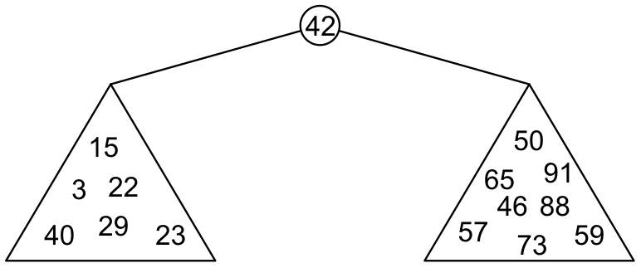
Binary Search Trees
Graphically, we may show the relationship as
Each of the two sub-trees will themselves be binary search trees

Slide 12
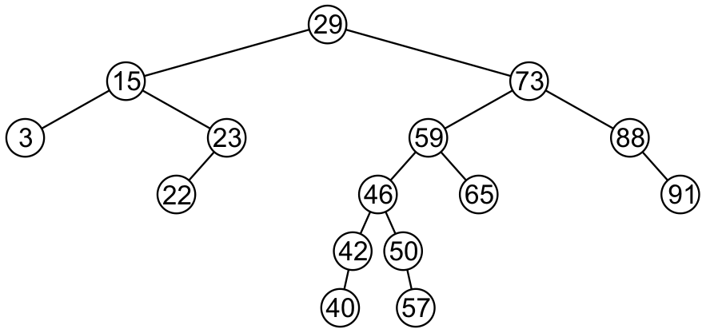
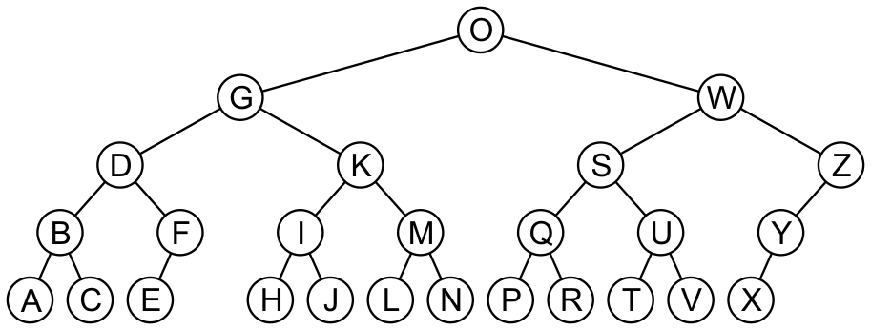
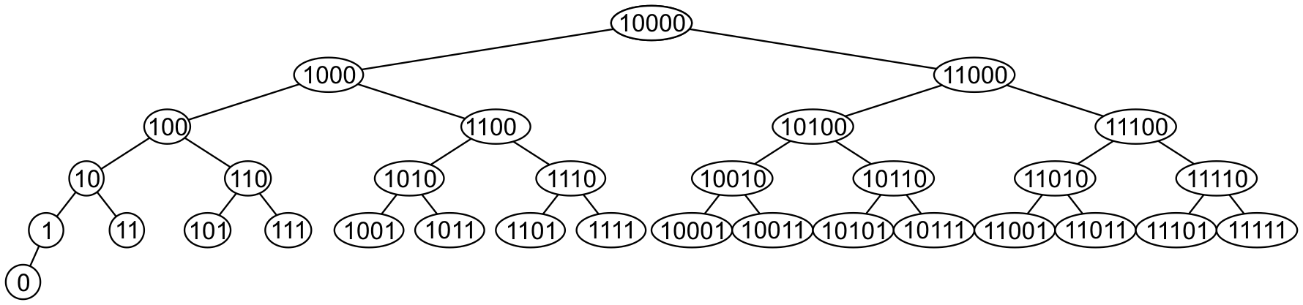
Examples
Here are other examples of binary search trees:

Slide 13
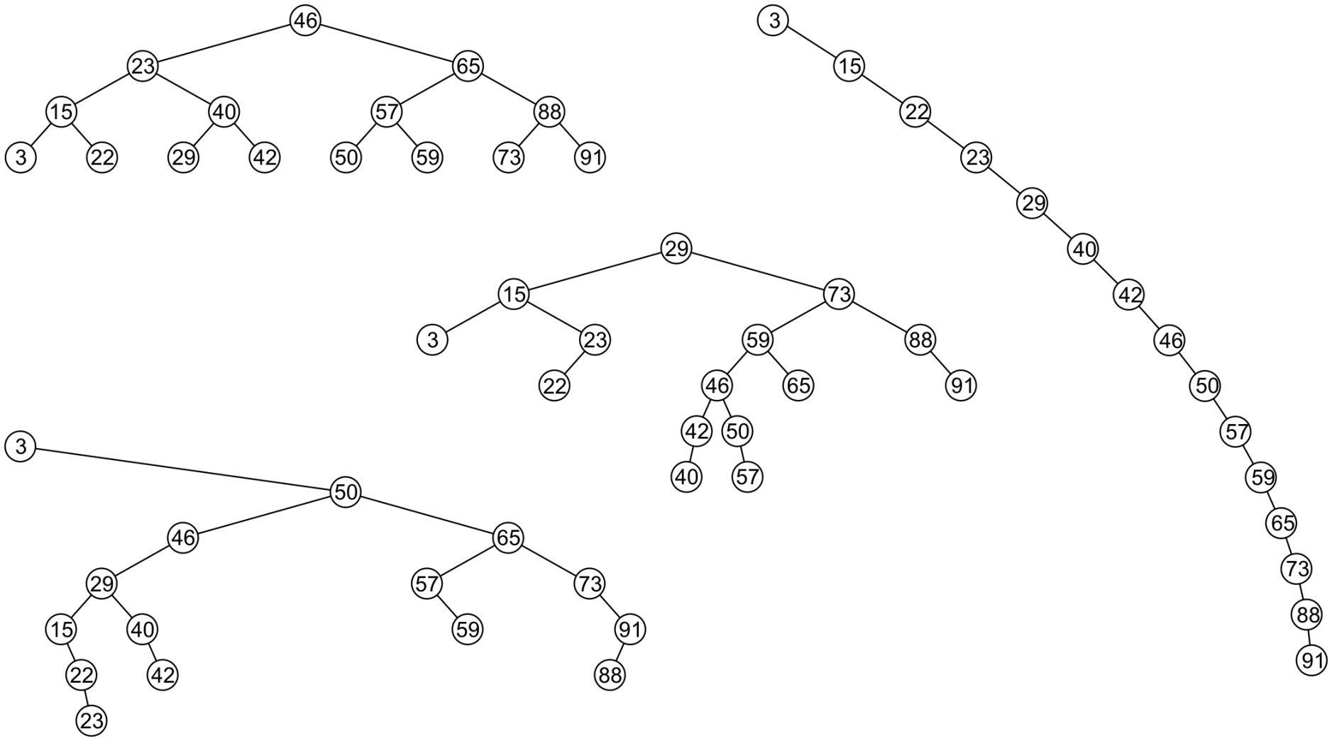
Examples
All these binary search trees store the same data

Slide 14
Quick Sort
A divide-and-conquer algorithm
Divide: partition array into 2 subarrays such that elements in the lower part <= elements in the higher part
Conquer: recursively sort the 2 subarrays
Combine: trivial since sorting is done in-place

Slide 15
Quick Sort
Inpalce sort
Average case O(n log n)
Worst case O(n²)
Partition of set in two halves
Best case :-> in two equal half
Worst case :->
2T(n/2) | + | n
Partition |  | Merge
T(1) | + | T(n-1) | + | n
Partition |  |  |  | Merge

Slide 16
Partitioning
Linear time partitioning procedure
15 | 13 | 16 | 3 | 7 | 82 | 8 | 10

Slide 17
Partitioning
Linear time partitioning procedure
15 | 13 | 16 | 3 | 7 | 82 | 8 | 10

Slide 18
Thank You

